Slide 1
“Globally, an estimated 736 million women—almost one in three—have been subjected to intimate partner violence, non-partner sexual violence, or both at least once in their life (30 per cent of women aged 15 and older)” – UN Women

Slide 2
“Violence against women, or gender-based violence, is a worldwide problem - and it's everyone's problem. It exists in virtually every culture on earth.” – Amnesty

Slide 3
How to go from #notallmen to supporting diversity, inclusion and equity
Cecilia Judmann

Slide 4
Agenda
What is white patriarchy
Why is #notallmen problematic?
What can we do?

Slide 5

What is white patriarchy?
Patriarchy
social organization marked by the supremacy of the father in the clan or family, the legal dependence of wives and children, and the reckoning of descent and inheritance in the male line
broadly : control by men of a disproportionately large share of power
Notes:
https://www.merriam-webster.com/dictionary/patriarchy

Slide 6
White patriarchy

Slide 7
What is white patriarchy
“The relationship between Occident and Orient is a relationship of power, of domination, of varying degrees of a complex hegemony”
“as much as the West itself, the Orient is an idea that has a history and a tradition of thought, imagery, and vocabulary that have given it reality and presence in and for the West” – Edward Said
Notes:
https://www.goodreads.com/author/show/16770310.Edward_W_Said

Slide 8
Why is #notallmen problematic?
Shifts focus
Fragile masculinity
Counterargument: #allmen

Slide 9
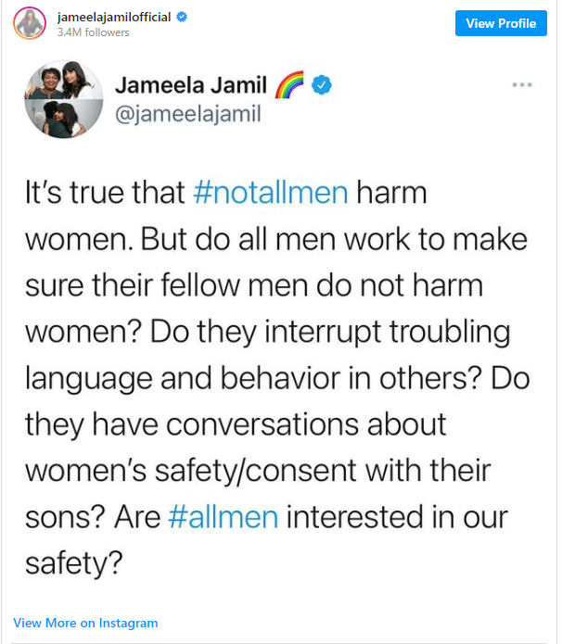
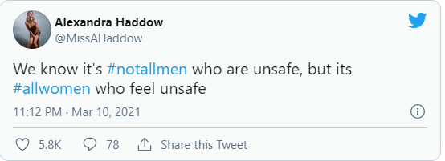
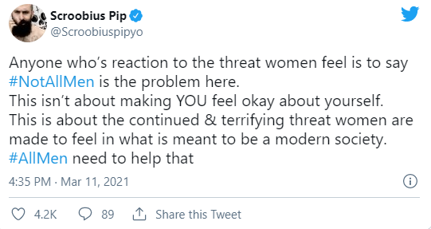
Why is #notallmen problematic?

Slide 10

What can we do?

Slide 11
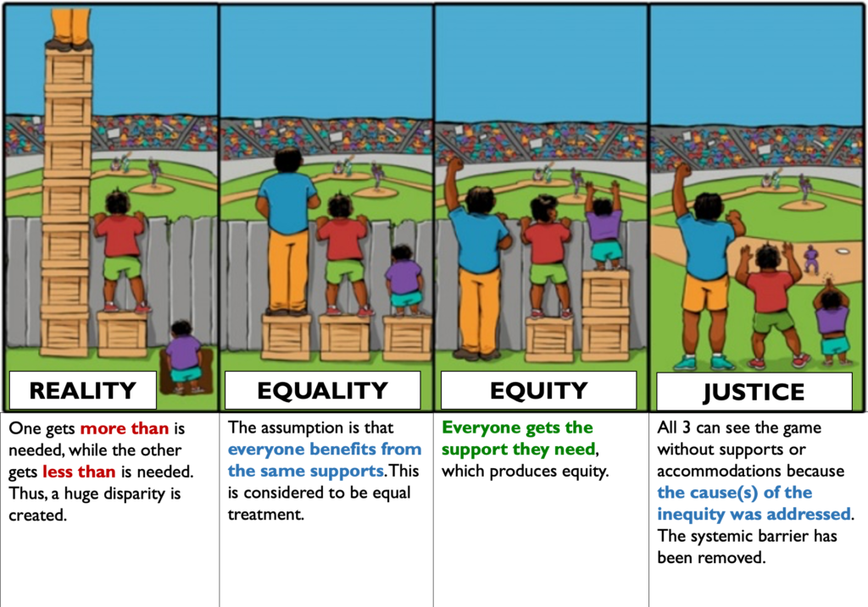

Slide 12
What can we do?
RESPECT women
Relationship skills strengthening
Empowerment of women
Services ensured
Poverty reduced
Enabling environments created
Child and adolescent abuse prevented
Transformed attitudes, beliefs and norms.
Notes:
https://www.who.int/publications/i/item/WHO-RHR-18.19

Slide 13
Empower women
Economic and social
Soft and hard skills
Mentoring and coaching

Slide 14
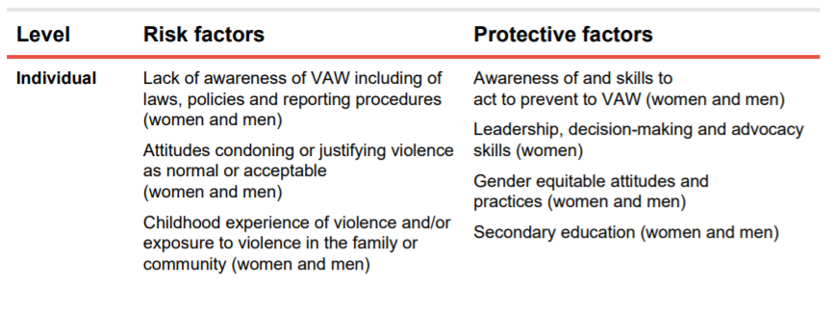
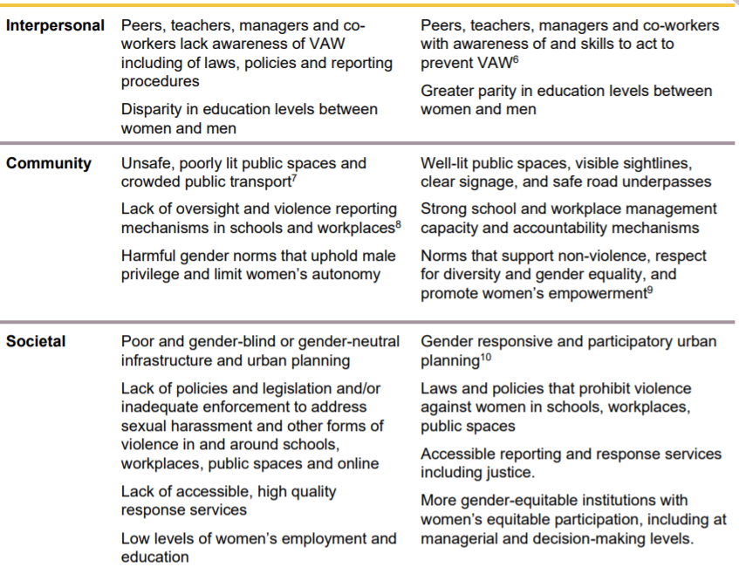
Environments made safe

Slide 15
Environments made safe

Slide 16
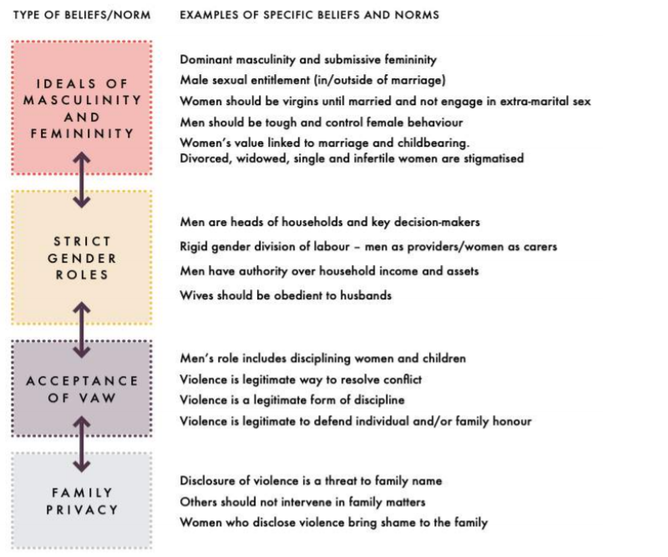
Transformed attitudes, beliefs and norms

Slide 17
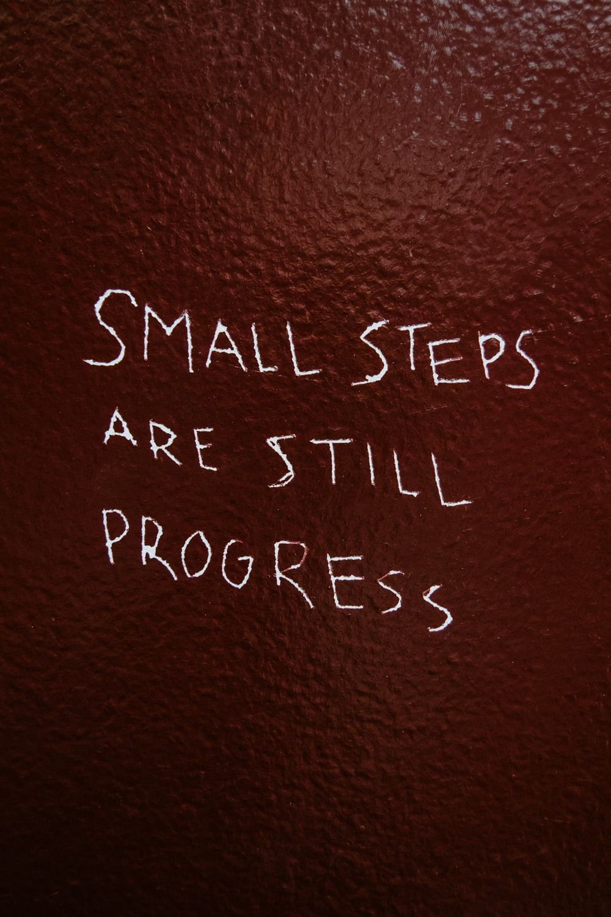
To summarise
Change the rules of the game
Self-analyse and change norms
Difficult and slow

Slide 18



Thanks
Please do get in touch with me to continue the conversation:
ceciliajudmann
@CJudmann

